Slide 1
Open House Show Case 22 October 2019 Community Service Ideas
Jim Simpson
RCNS Chair,
Community Service Committee

Slide 2
Presentation Outline
Community Service Aims, Grouping
Donating to the Community
Working in the Community
Fundraising Plan

Slide 3
Rotary Club of Norfolk Sunrise Working Structure
 |  |  | President RCNS
 |  | Pres Elect Past Pres |  | Secty Treas
Community Service | International Service | Youth and Exchange | Ways and Means | PR and Comms | Finances | Club Services

Slide 4
Aims, Grouping
Community Service Aim(s)
- identify community needs that align with Rotary ideals and that the club can support in a meaningful way
- use an objective process to select service projects for the club to support in the Norfolk area; and
- oversee and coordinate the work of all ad-hoc committees appointed on particular phases of community service.
Community Service Grouping
Responsible to the RCNS Club, through the Board of Directors
Budget – anywhere from $8K to $44K
---------------------------------------------------
Chair; Jim Simpson
Members; Kate Stratford, Jim Peters, Helga Streumer, Dave Douglas, Scott Williams, Dave Bradshaw

Slide 5
Fundraising Plan - Ways & Means
Casino Royale
Bargains Bling & Blarney
Ride for Rotary
Car Rally
Wall of Money
Catch the Ace

Slide 6
Donating to the Community
Youth
Literacy
Simcoe Sunrise Trail
Com Dev
Others
Indwell
Health
Welfare
Fitness
Waterford Shadow Lake Trail
Todd Eaton Fitness Track
Special Olympics
Church Out Serving
Norfolk Gen Hospital
Lighthouse Theatre
Norfolk Literacy Council
Panorama Farmer Market
Library Teen Write
Gateway Signs
Big Brothers, Big Sisters
Women’s Service
Pregnancy & Fam Res Centre
Agri Awareness
Community Help Centre
Habitat for Humanity
Assisted Community Living
Addiction & Mental Health
Young Theatre Players
Coats for Kids
Raised Gardens
Children’s Nutrition Network
RISE Anti-Poverty Group
Community Skate-Board Parks
Lighthouse Seat Repl
Pikangikum School
Touch of Haven
Palliative Care Centre
LS King School
Santa Breakfast
Murals

Slide 7
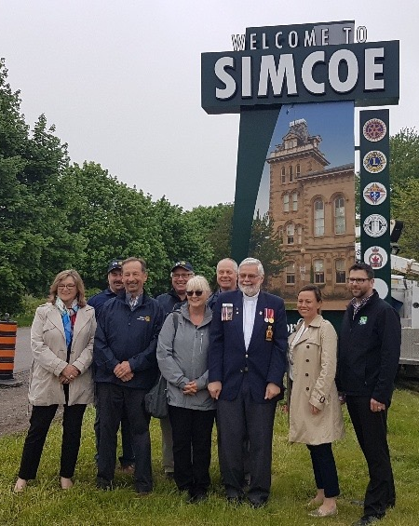
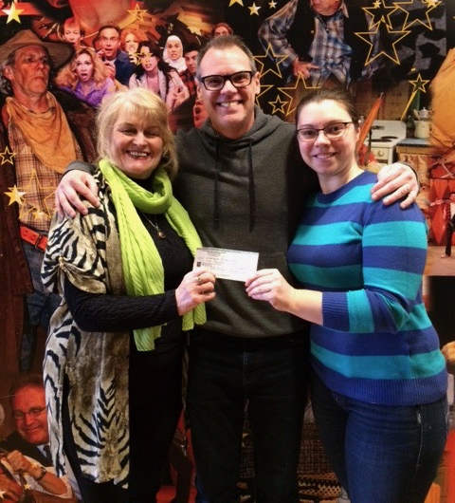
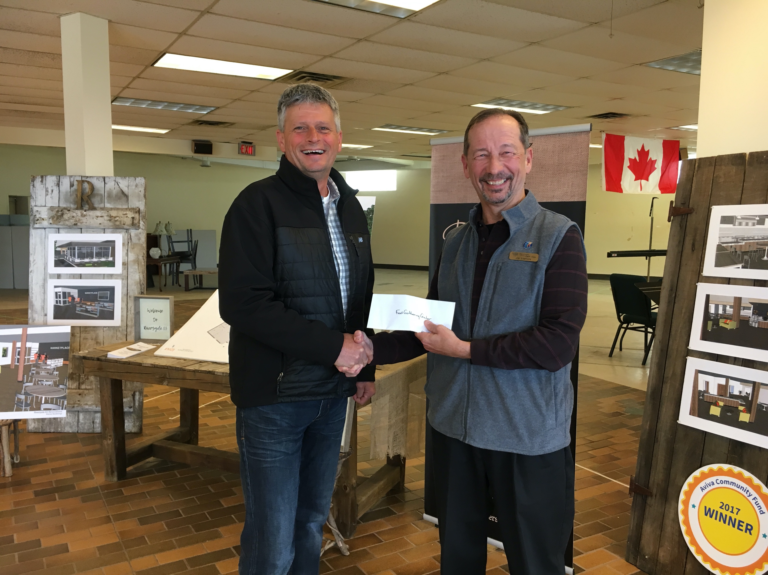
Donating to the Community Photos (1)

Slide 8
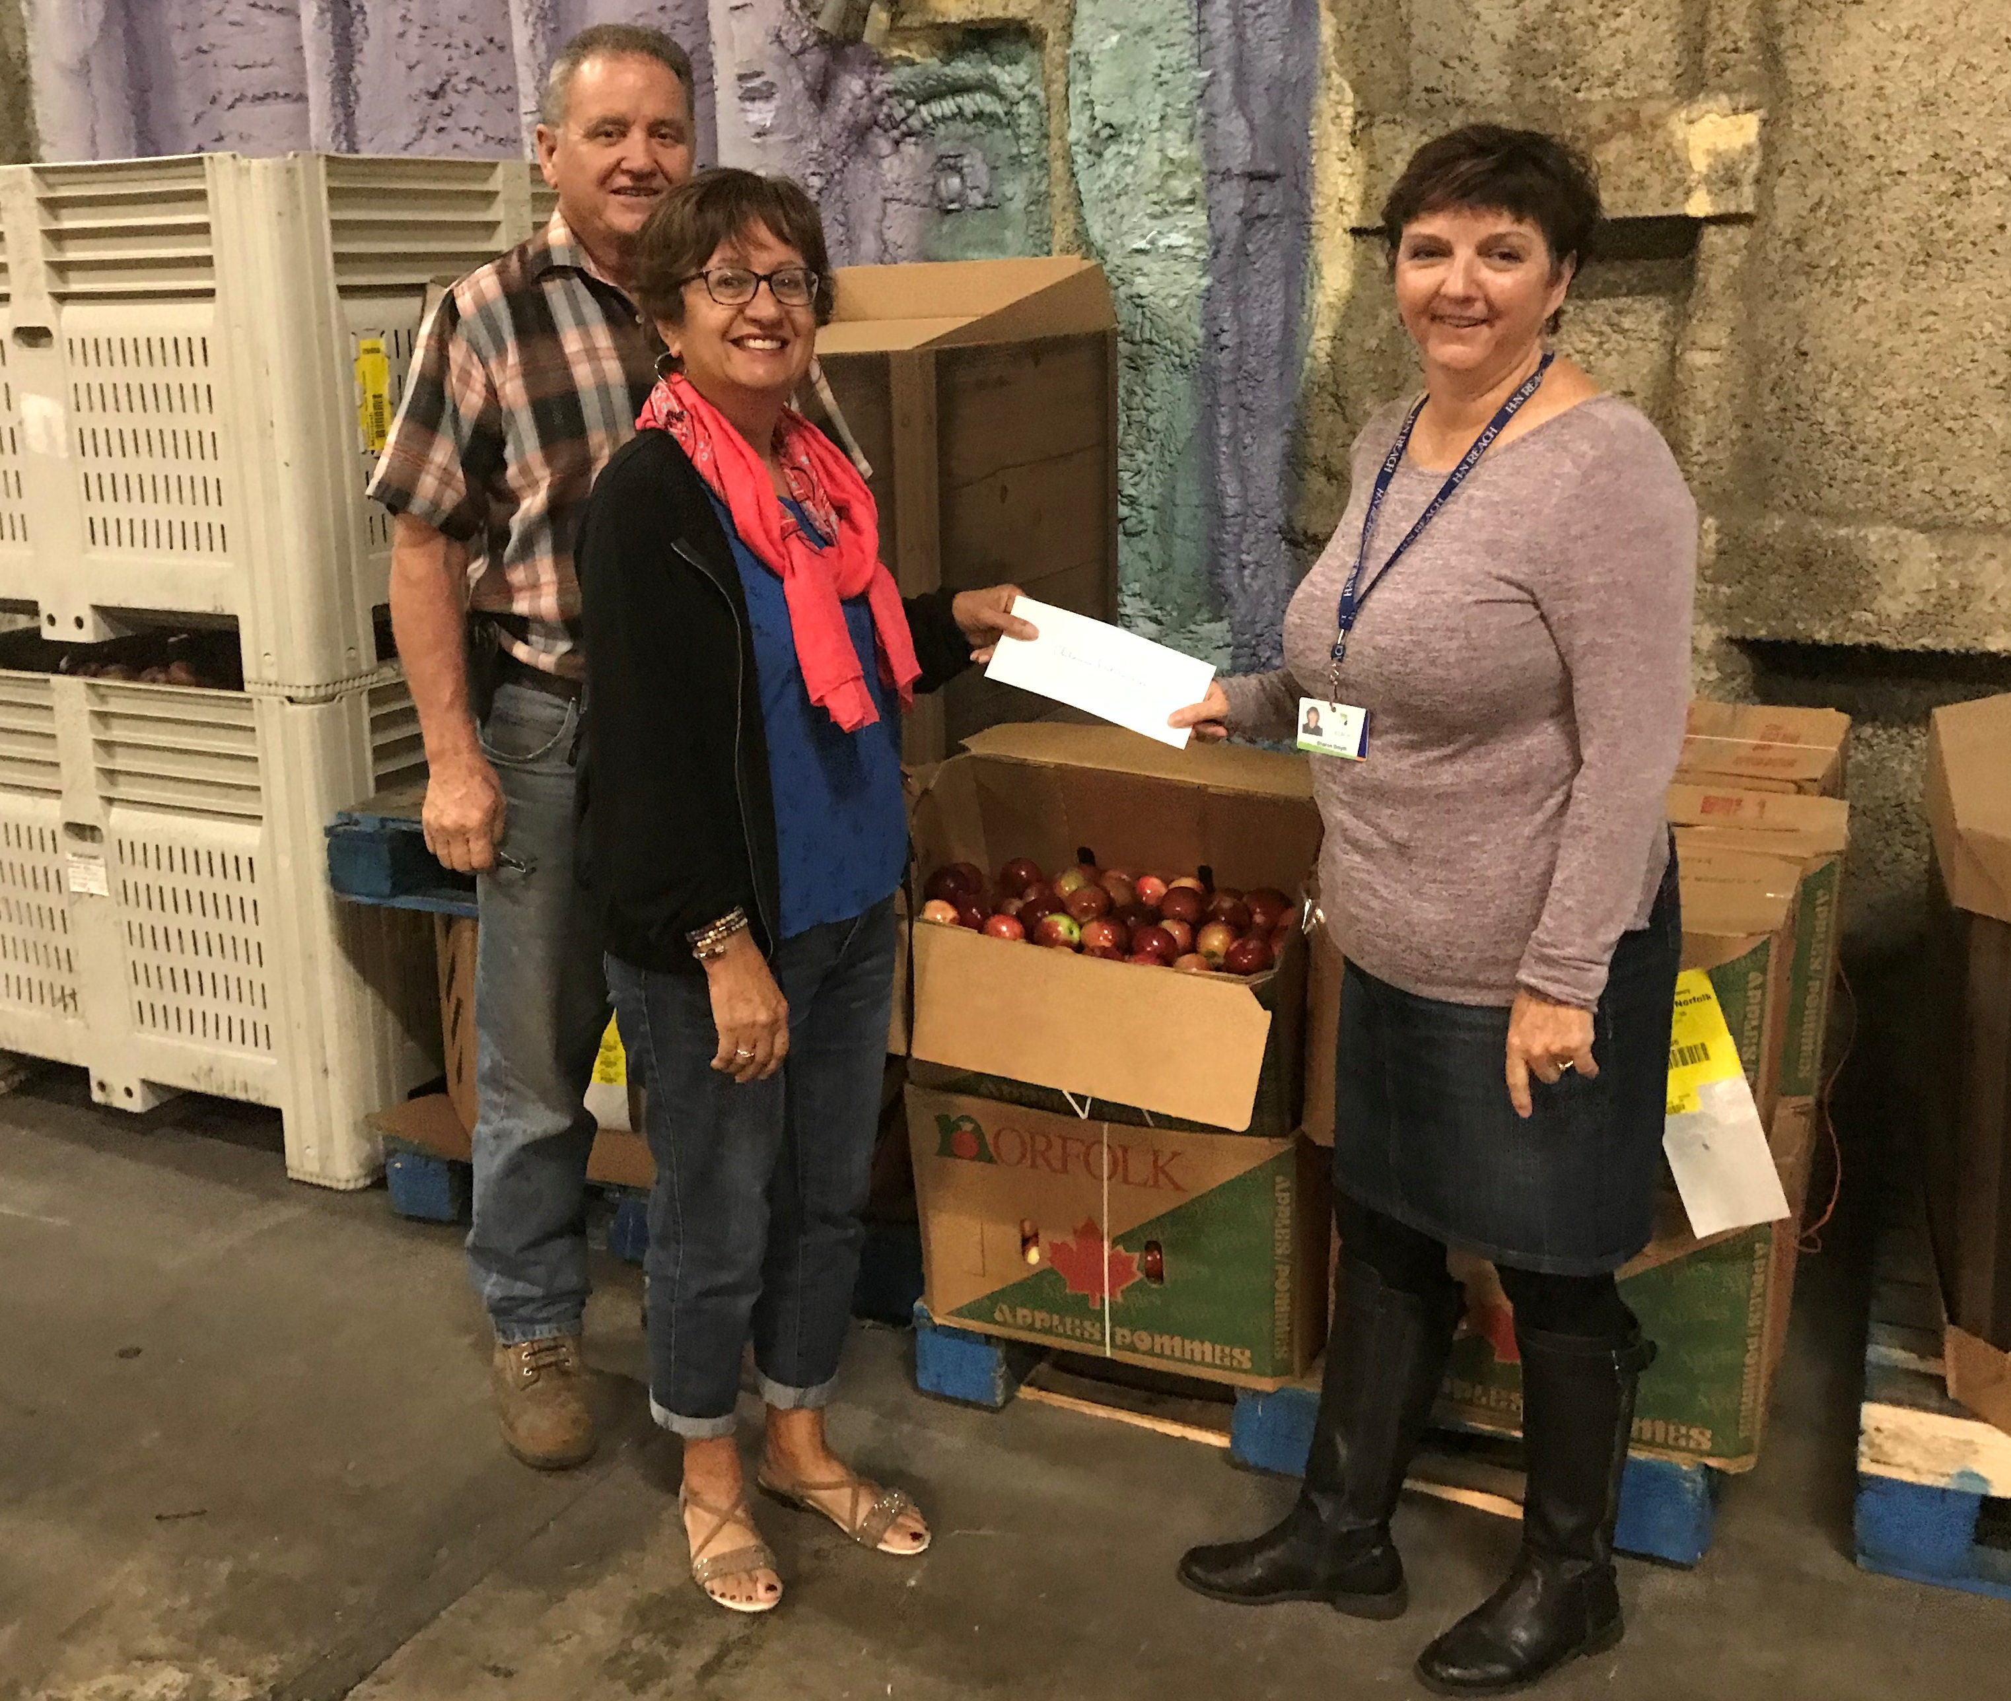
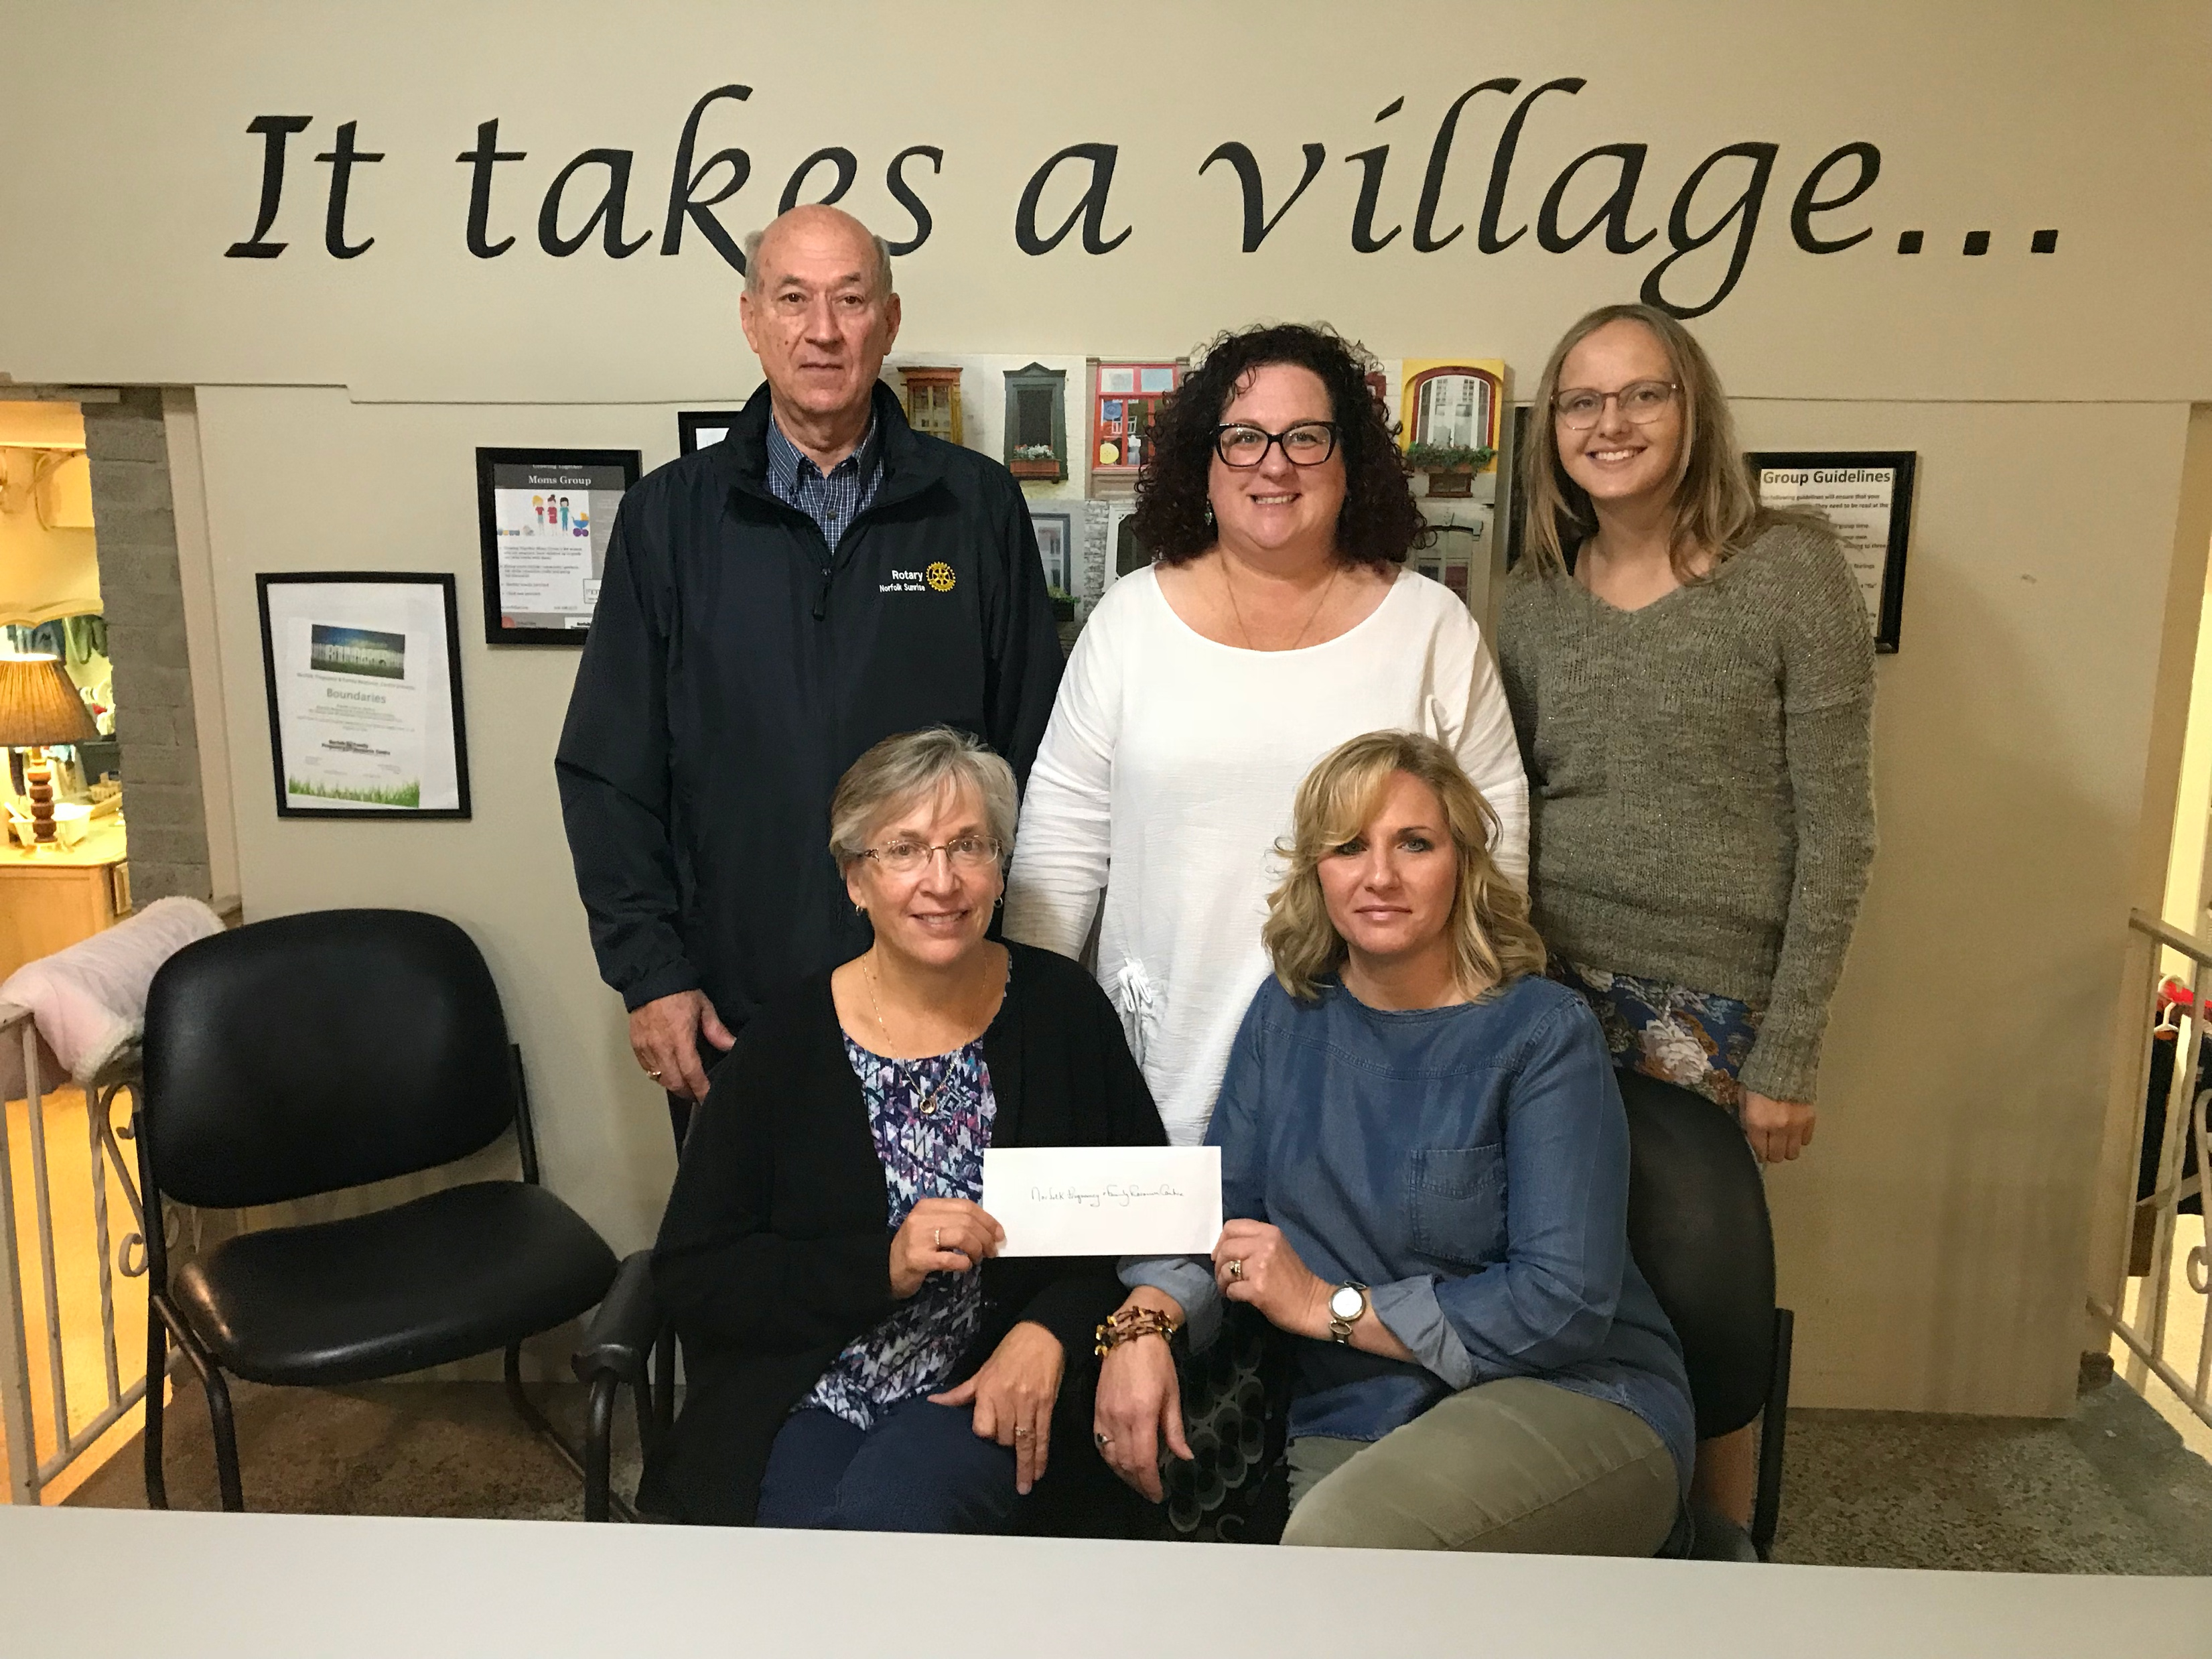
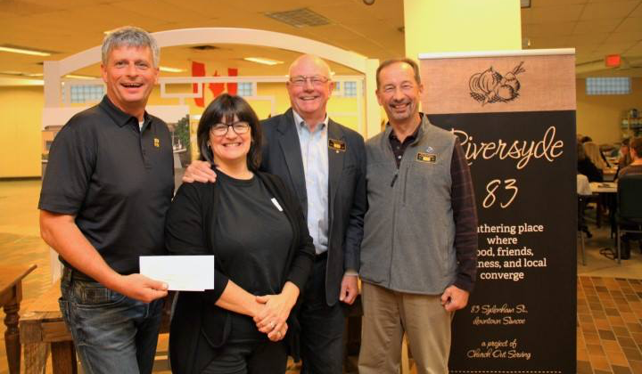
Donating to the Community Photos (2)

Slide 9
Working in the Community
Inside
Habitat for Humanity
Outside
Simcoe Sunrise Trail
Others
Day’s of Action
Murals
Raised Gardens
Riversyde 83
NACL
Homes
Indwell
Race

Slide 10
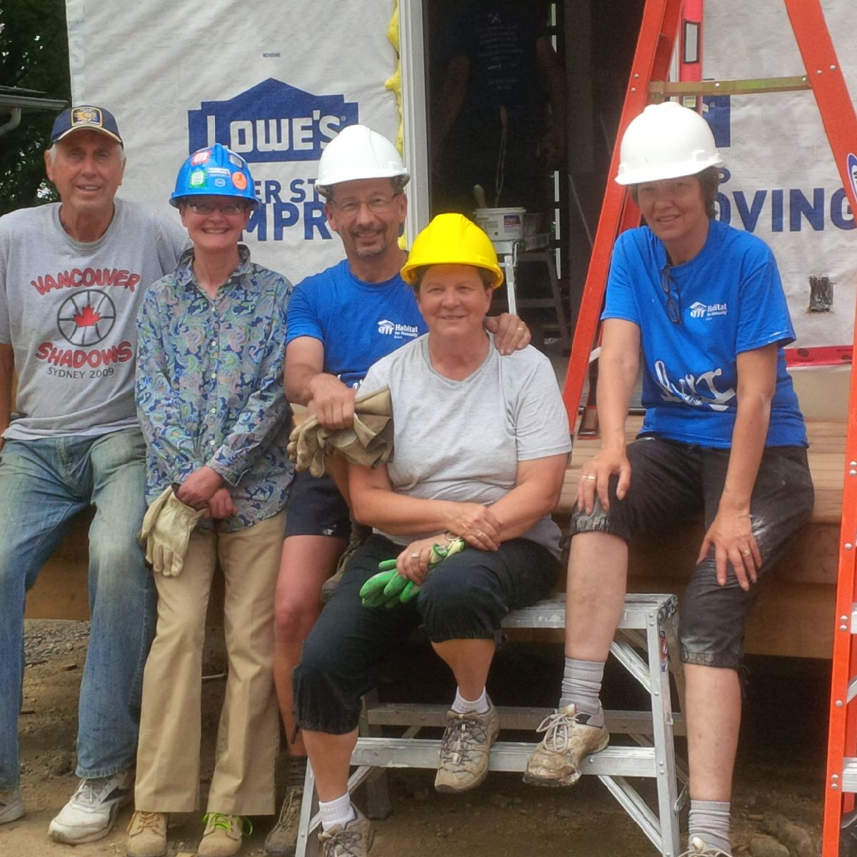
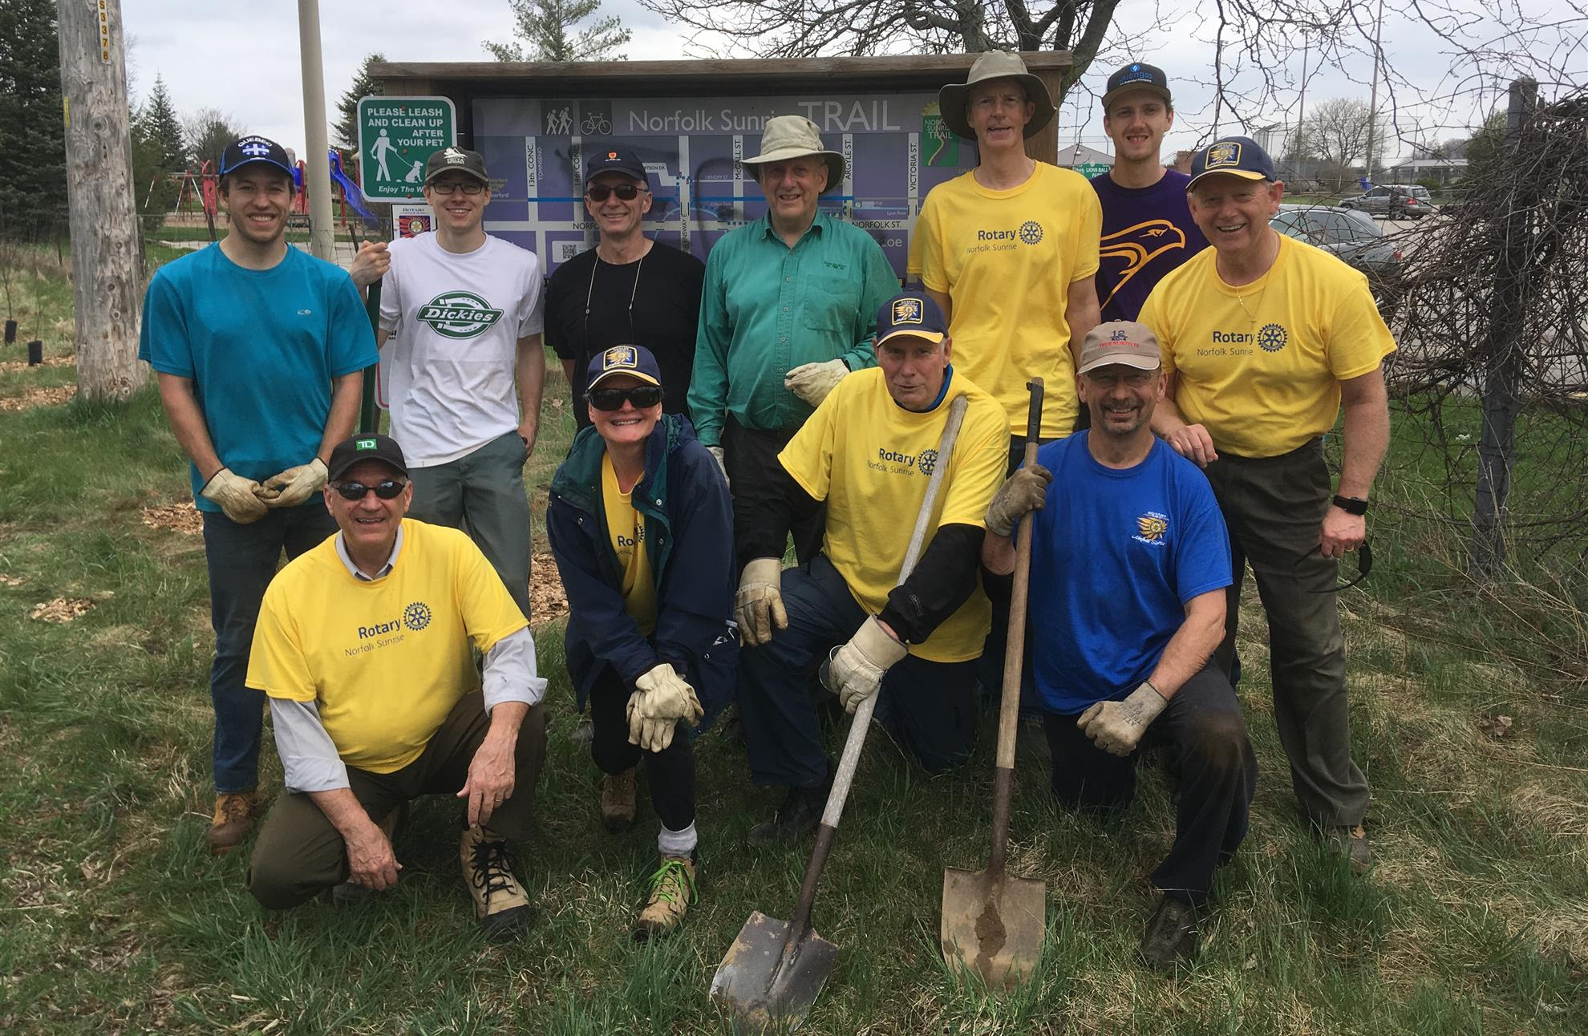
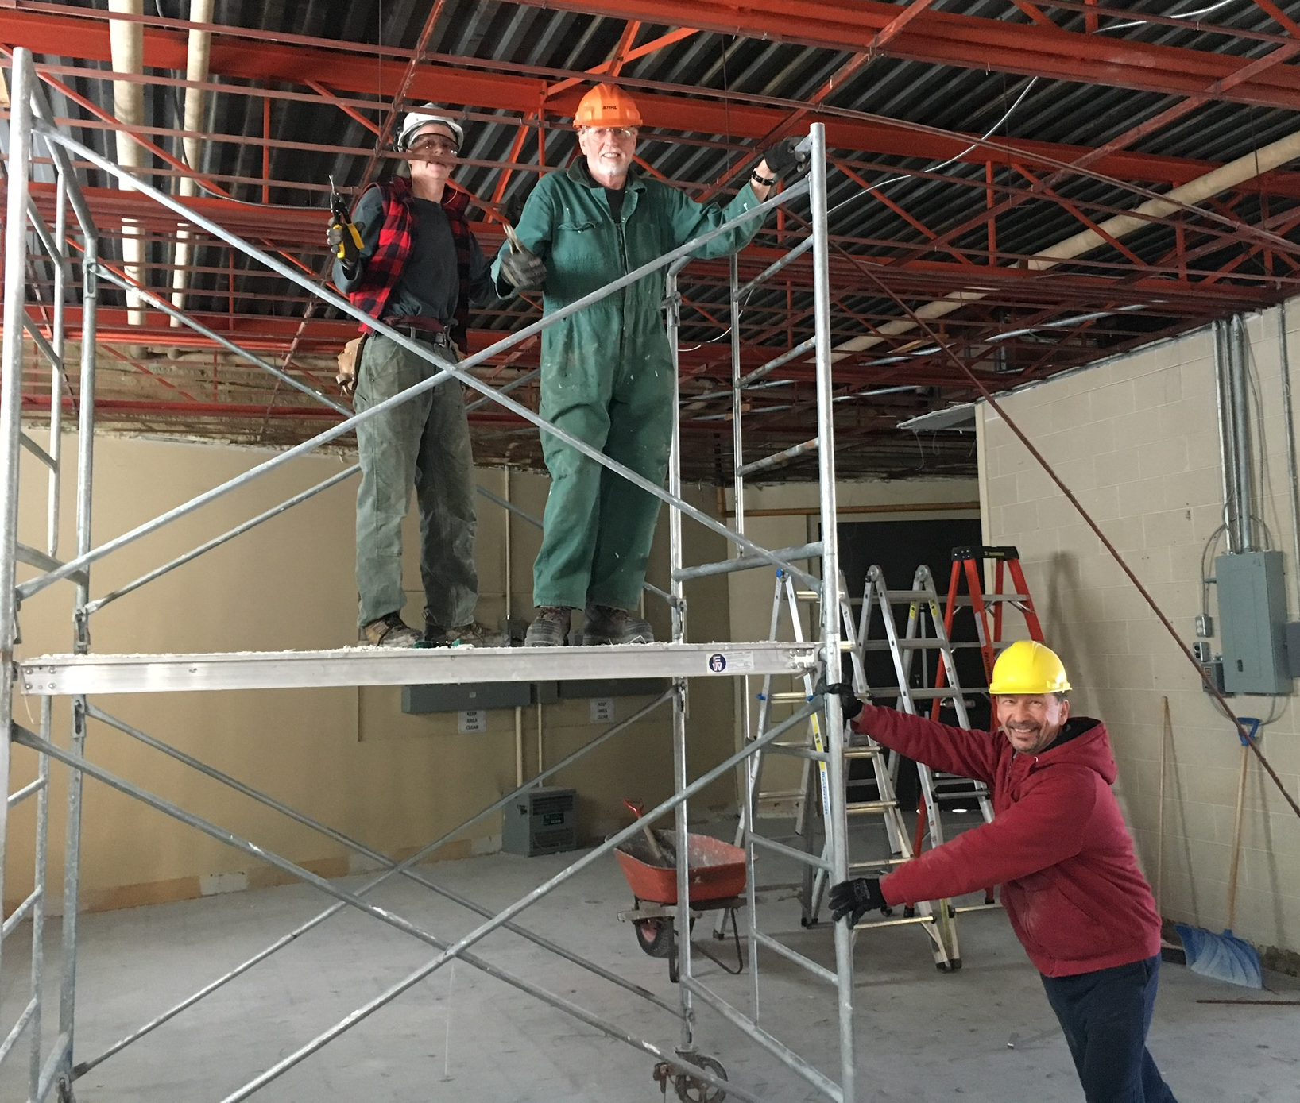
Working in the Community Photos (1)

Slide 11
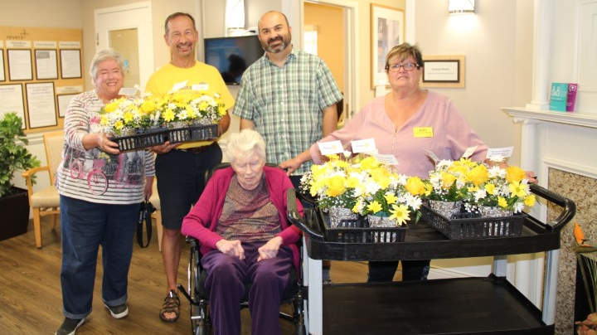
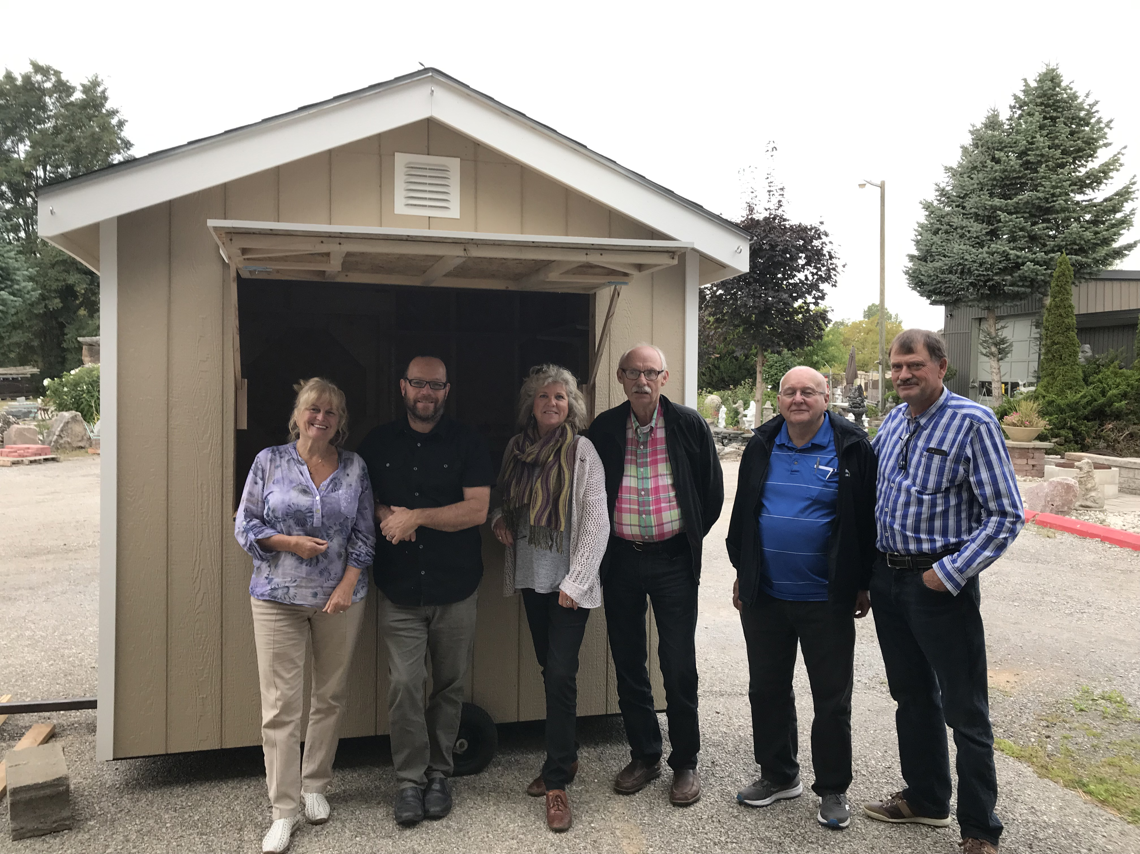
Working in the Community Photos (2)

