Slide 1
RC Norfolk Sunrise in partnership with Operation Eyesight:
Kanpur- Five Vision Centres around Kanpur India
project supplied equipment and operating expenses to initiate 5 vision centres serving 50,000 people each
All centres opened in November and the project covers first year operating costs

Slide 2
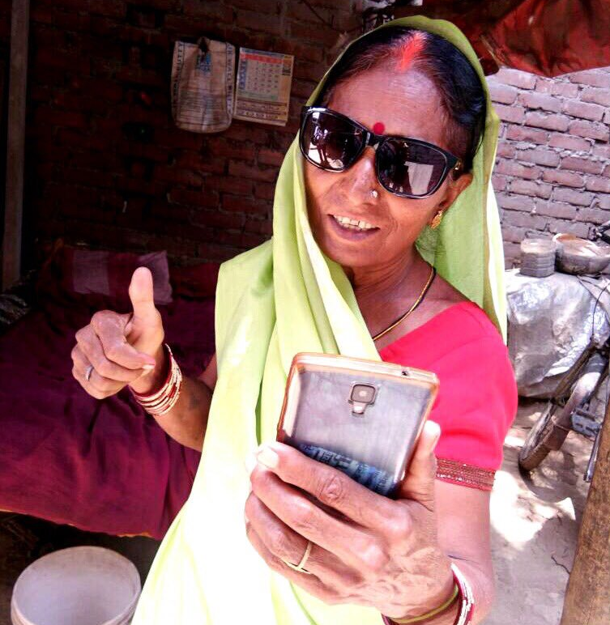
Women just received
eye surgery and
celebrates with selfie

Slide 3
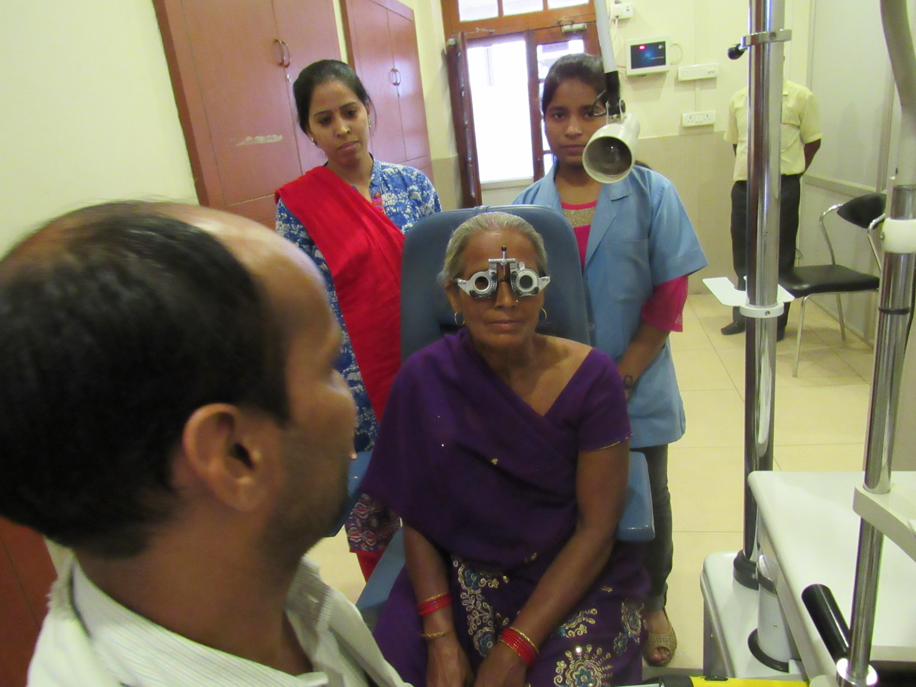
Vision centres equipped
with modern equipment
and fully trained
optometrists

Slide 4
Kampur Vision Centres
Status as of Aug 2019
Patients screened 4576
Spectacles provided 2065
Surgeries conducted 879
Average patients per day 23.4

Slide 5
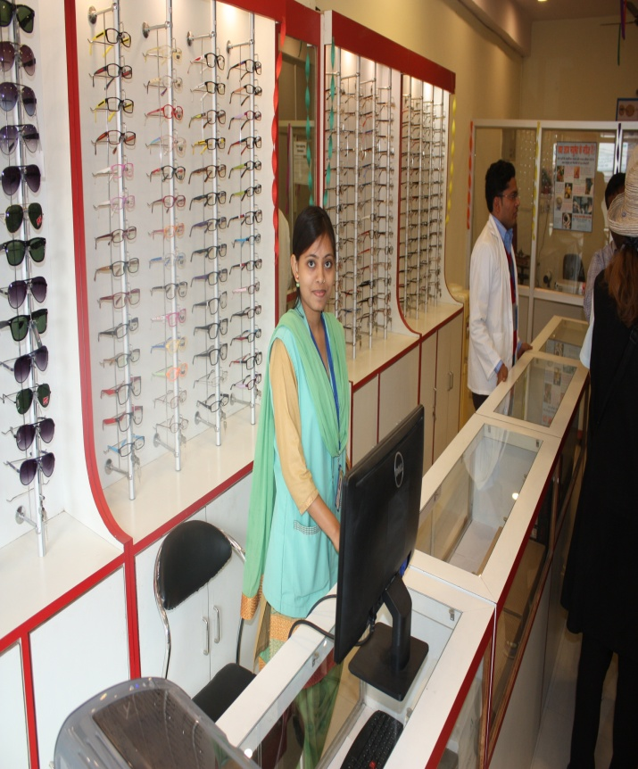
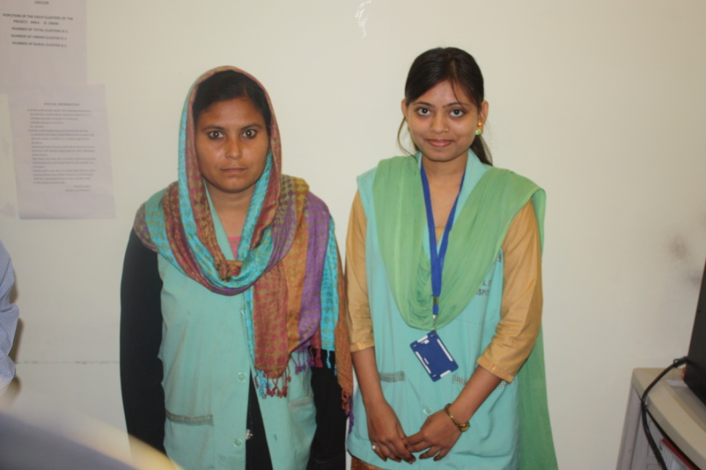
Visiting Vision Centre (near Kanpur) Self- sustaining by revenue from glasses sales and eye examinations by those who can pay

Slide 6
How Kanpur Project is funded
RC Norfolk Sunrise $14,000
RC Simcoe $ 4,800
RC Brantford Sunrise $10,000
District 7090 $10,000
RC Kanpur Metro $ 3,000
RC Kanpur Shaurya $ 3,000
Rotary Foundation $27,400
Total funding $72,200
(all $US)

